Slide 1

Micro-frontends
c1
REX CHEZ

Slide 2
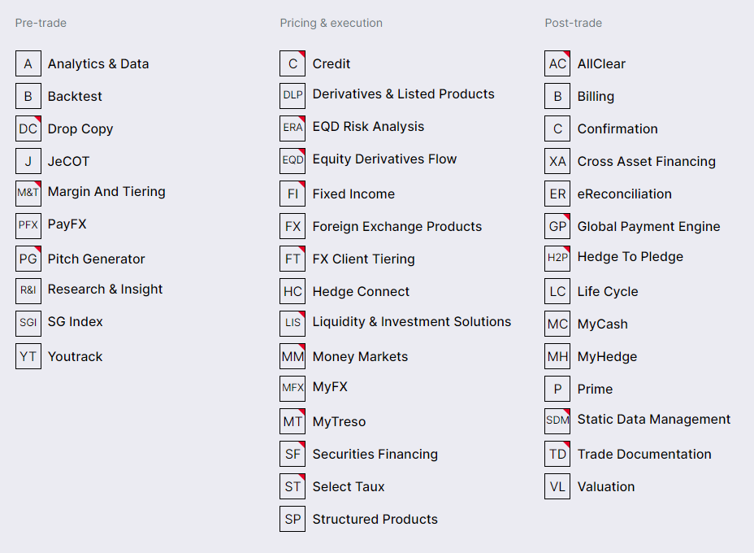











SG|MARKETS
Societe Generale's marketplace of BtoB services

Slide 3
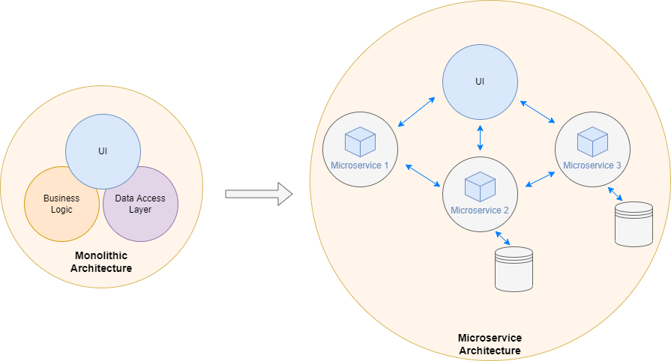
INTRO

Slide 4
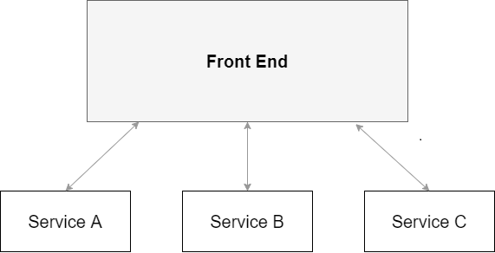
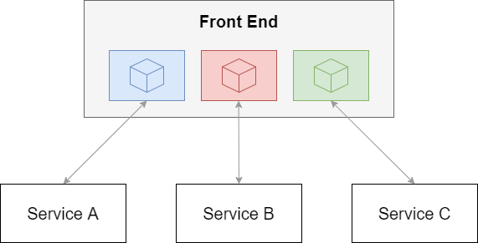
INTRO

Slide 5
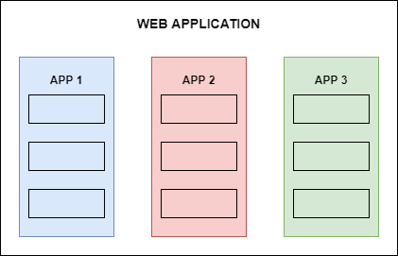
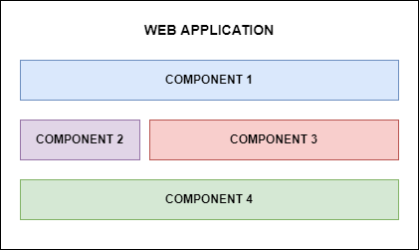
INTRO
VERTICAL SPLIT
HORIZONTAL SPLIT

Slide 6

BENEFITS
Split big website into sub-modules
One team per module
(separate deployment & development)
Improve website maintenability
(lib upgrades, refactoring)
Improve developer experience

Slide 7
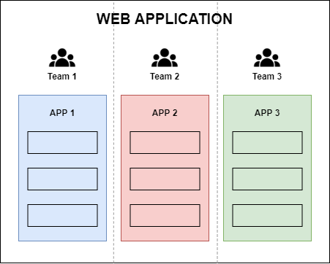
BENEFITS

Slide 8
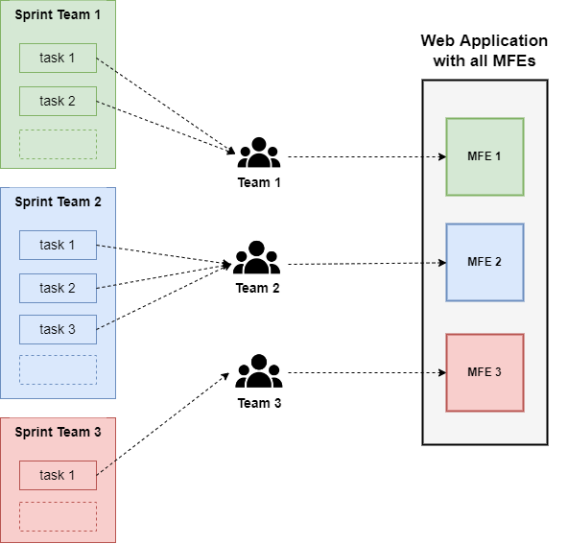
ORGAnization

Slide 9
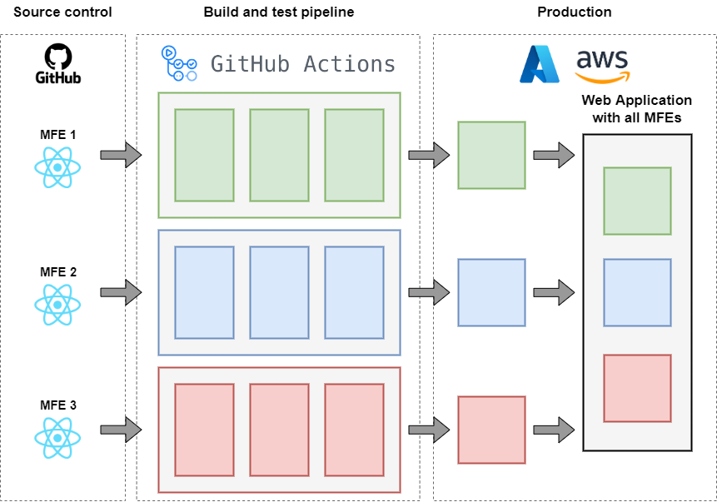
DELIVERY

Slide 10
OK for the organization side…
but how can we implement it ?
NOW the tech part !
Notes:
Romain

Slide 11

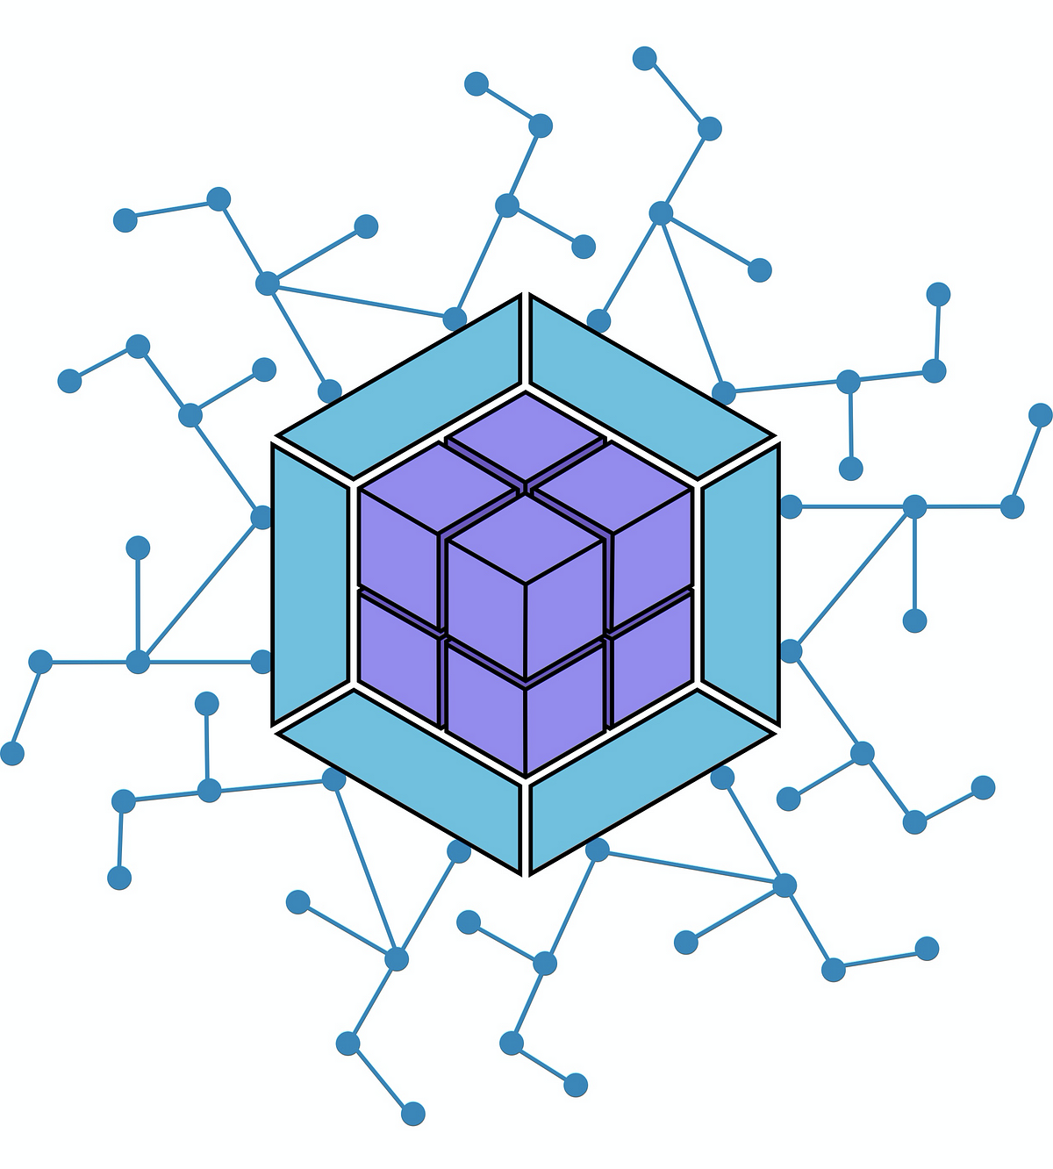
HOW
One standard : module-federation
Works natively with Webpack
Works with React, Vue & Angular
(for Angular : @angular-architects/module-federation)
Works now with Vite and Next.js
Zack Jackson

Slide 12
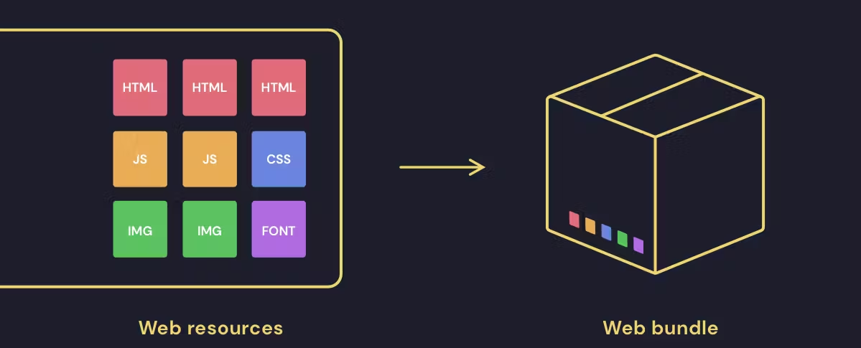
WEB BUNDLER

Slide 13
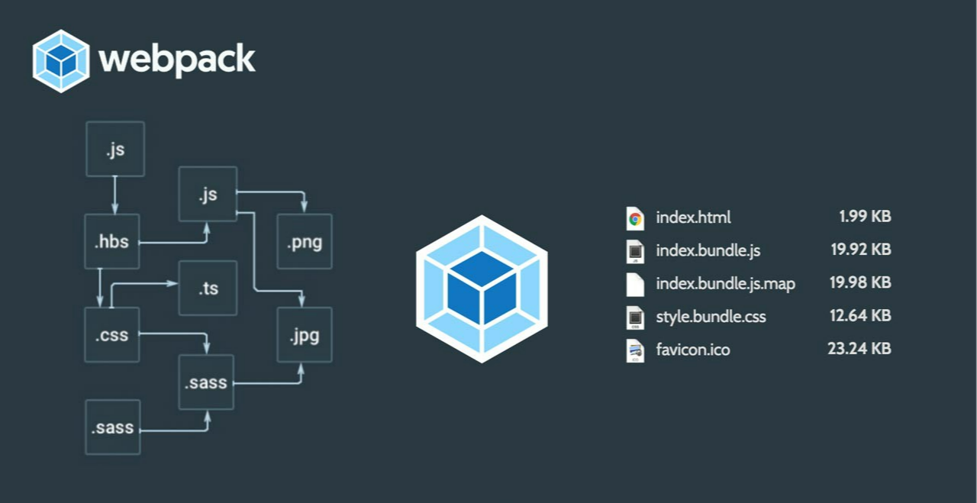
WEB BUNDLER

Slide 14

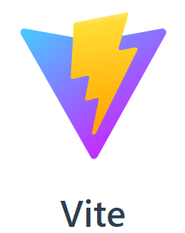



WEB BUNDLER
NEW !
NEW !

Slide 15
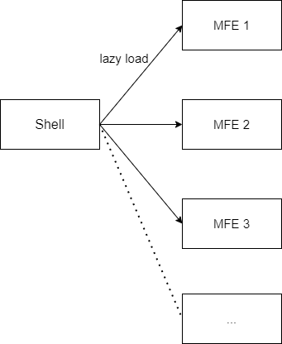
Implementation

Slide 16
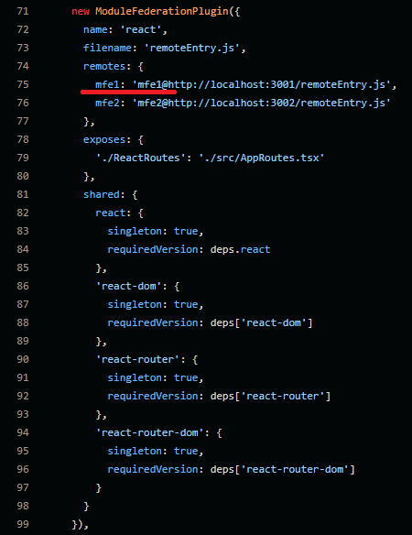
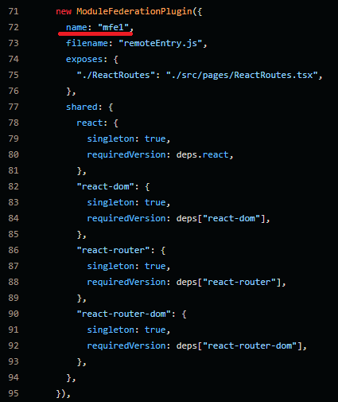
Shell App
MFE1 App
WEBPACK
MODULE-
FEDERATION

Slide 17





CHRONOLOGY
Webpack Module-federation released
Module Federation supports Next.js
Module Federation supports Vite
Nov 2020
Feb 2022
Mar 2020
Jan 2022
Dec 2022
Angular Architects released
Module Federation supports Node.js

Slide 18

IC : CRM web application
Feature-teams segregation
ic-crm
sgm-contact
4 releases / week
CONCRETE
CASE

Slide 19
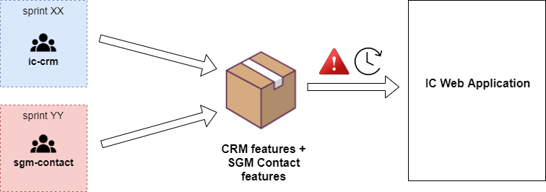

CONCRETE CASE

Slide 20
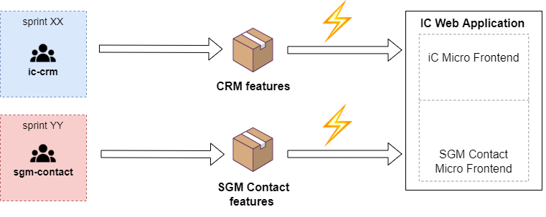
CONCRETE CASE

Slide 21
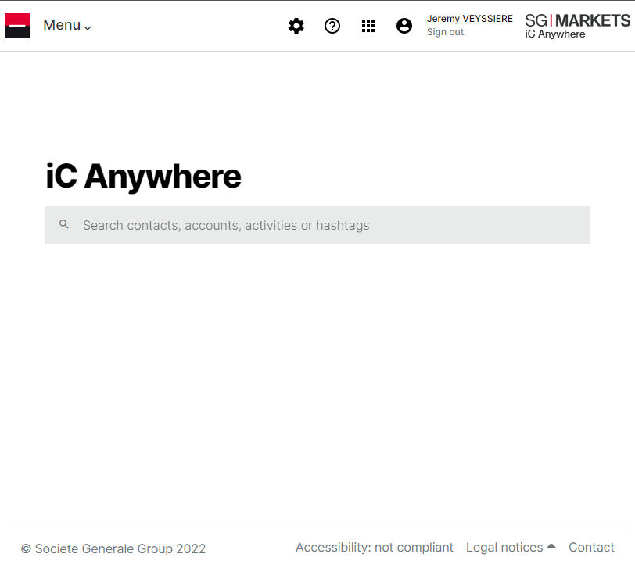
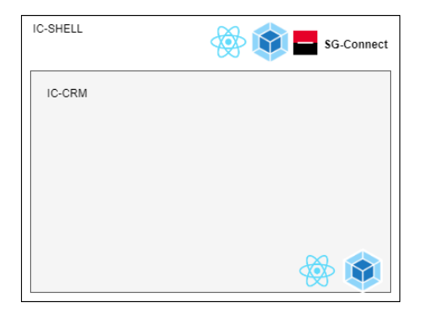
CONCRETE CASE

Slide 22
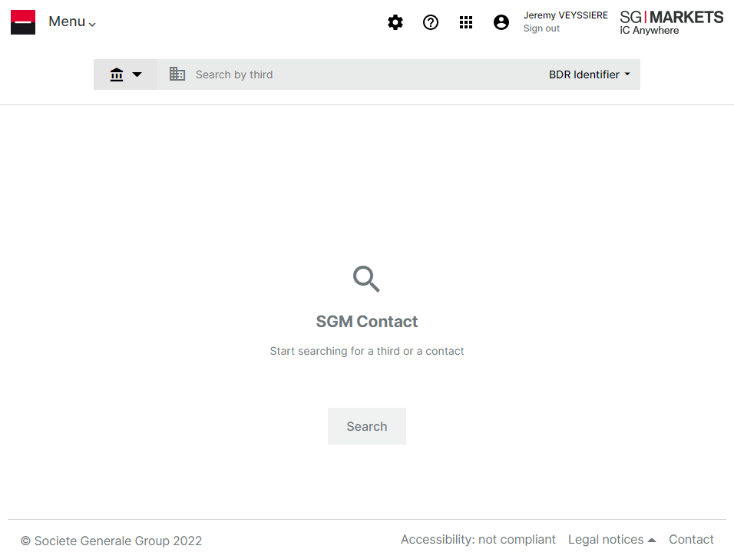
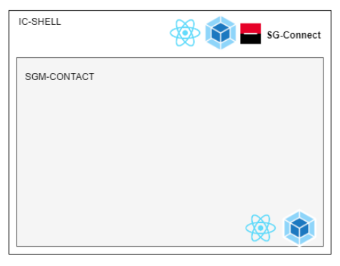
CONCRETE CASE

Slide 23
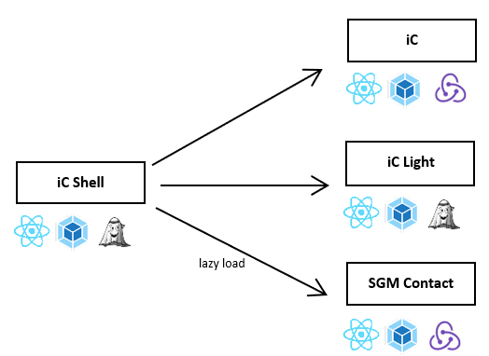
CONCRETE CASE

Slide 24

Avoid code duplication
Define communication between micro-frontends
Define functional domains
WARNINGS !

Slide 25
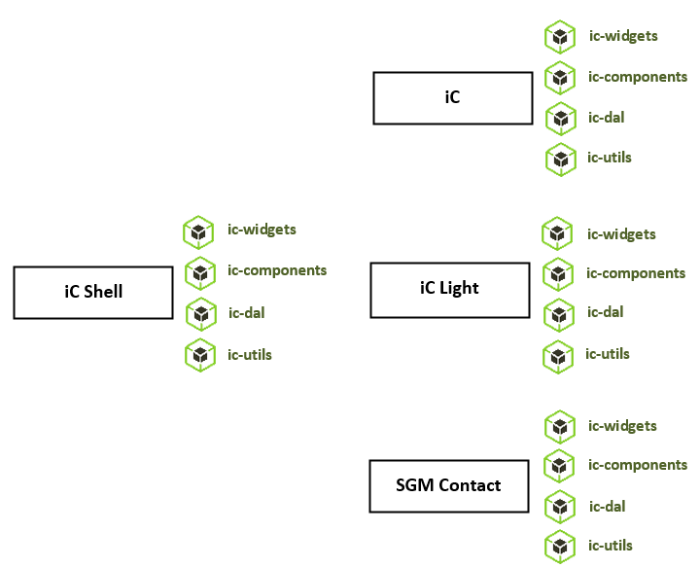
CONCRETE CASE

Slide 26



ON INFRASTRUCTURE
Each micro-frontend is a static website
Usage of public cloud provider
Usage of :
Azure CDN Profile
Azure Block Storage
Green IT : reduce CO2e

Slide 27

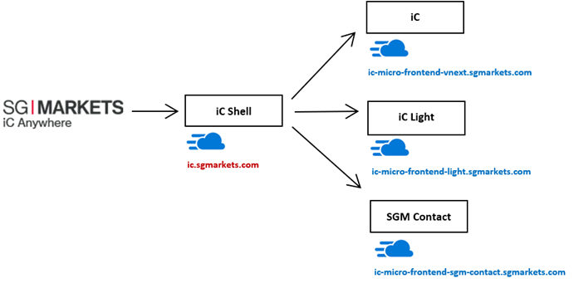
On infrastructure

Slide 28

WHEN USE IT ?
Use it for
Improve feature teams collaboration
Sharing navigation between apps
Improve change management
Do not use it for
Speed up application build time
Improve app loading in web browser

Slide 29

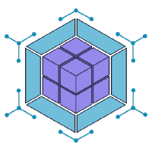
LEARN
Module Federation
https://github.com/module-federation

